Slide 1
Phishing attack
PRESENTED BY:
P.THIRISHA – HOLYCROSS ENGINEERING COLLEGE – CSE Dept

Slide 2
contents
Introduction
What is phishing ?
How does phishing work ?
Types of phishing
Phishing Examples
What are the dangers of phishing attack ?
How do I protect against phishing attacks ?
Four way to protect yourself from phishing
Causes of Phishing
Effects of Phishing
Conclusion

Slide 3
INTRODUCTION
Early phishing techniques can be traced back to the 1990s, when black hat hackers and the warez community used AOL to steal credit card information and commit other online crimes. The term "phishing" is said to have been coined by Khan C.
Phishing is the most common type of social engineering, the practice of deceiving, pressuring or manipulating people into sending information or assets to the wrong people.
It is usually done through email. The goal is to steal sensitive data like credit card and login information, or to install malware on the victim's machine.

Slide 4
WHAT IS PHISHING ?
“Phishing” refers to an attempt to steal sensitive information, typically in the form of usernames, passwords, credit card numbers, bank account information or other important data in order to utilize or sell the stolen information. By masquerading as a reputable source with an enticing request, an attacker lures in the victim in order to trick them, similarly to how a fisherman uses bait to catch a fish.
Phishing attacks are the practice of sending fraudulent communications that appear to come from a reputable source.

Slide 5
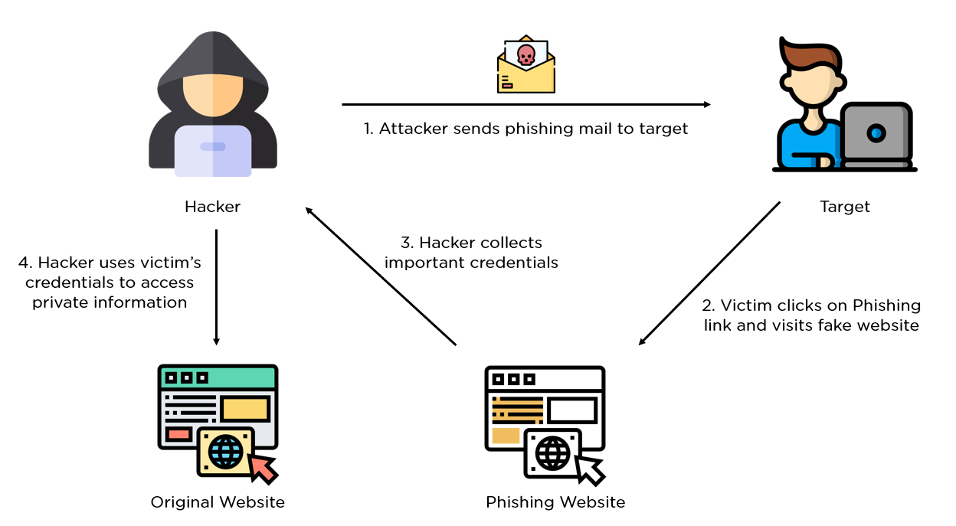
HOW DOES PHISHING WORK ?

Slide 6
Types of phishing
Deceptive Phishing
Spear Phishing
Whaling
Pharming

Slide 7
TYPE OF PHISHING
1. Deceptive Phishing
Deceptive phishers use deceptive technology to pretend they are with a real company to inform the targets they are already experiencing a cyberattack. The users then click on a malicious link, infecting their computer.
Example of Deceptive Phishing
Users were sent emails that came from the address support@apple.com and had “Apple Support” in the sender information. The message claimed that the victim’s Apple ID had been blocked. They were then prompted to validate their accounts by entering information the hacker would use to crack it.

Slide 8
2. Spear Phishing
Spear phishing involves targeting a specific individual in an organization to try to steal their login credentials. The attacker often first gathers information about the person before starting the attack, such as their name, position, and contact details.
Example of Spear Phishing
An attacker tried to target an employee of NTL World, which is a part of the Virgin Media company, using spear phishing. The attacker claimed that the victim needed to sign a new employee handbook. This was designed to lure them into clicking a link where they would have been asked to submit private information.

Slide 9
3. Whaling
A whaling attack is a phishing attack that targets a senior executive. These individuals often have deep access to sensitive areas of the network, so a successful attack can result in access to valuable info.
Example of Whaling
A founder of Levites, an Australian hedge fund was the target of a whaling attack that led the individual to a fake connection using a fraudulent Zoom link. After following the link, they had malware installed on their system, and the company lost $800.000

Slide 10
4. Pharming
In a pharming attack, the victim gets malicious code installed on their computer. This code then sends the victim to a fake website designed to gather their login credentials.
Example of Pharming
In 2007, a complex pharming attack went after at least 50 financial institutions across the world. Users were directed to false websites and instructed to enter sensitive information.

Slide 11
PHISHING EXAMPLE
Real-World Examples of Phishing Email Attacks
One common thread that runs through all types of phishing emails, including the examples below, is the use of social engineering tactics. Like most phishing attacks, social engineering preys on the natural human tendency to trust people and companies.
This leads to many users failing to carefully review phishing email details and automatically trusting the sender’s request. Email phishing victims believe they’re helping their organizations by transferring funds, updating login details, or providing access to proprietary data.

Slide 12
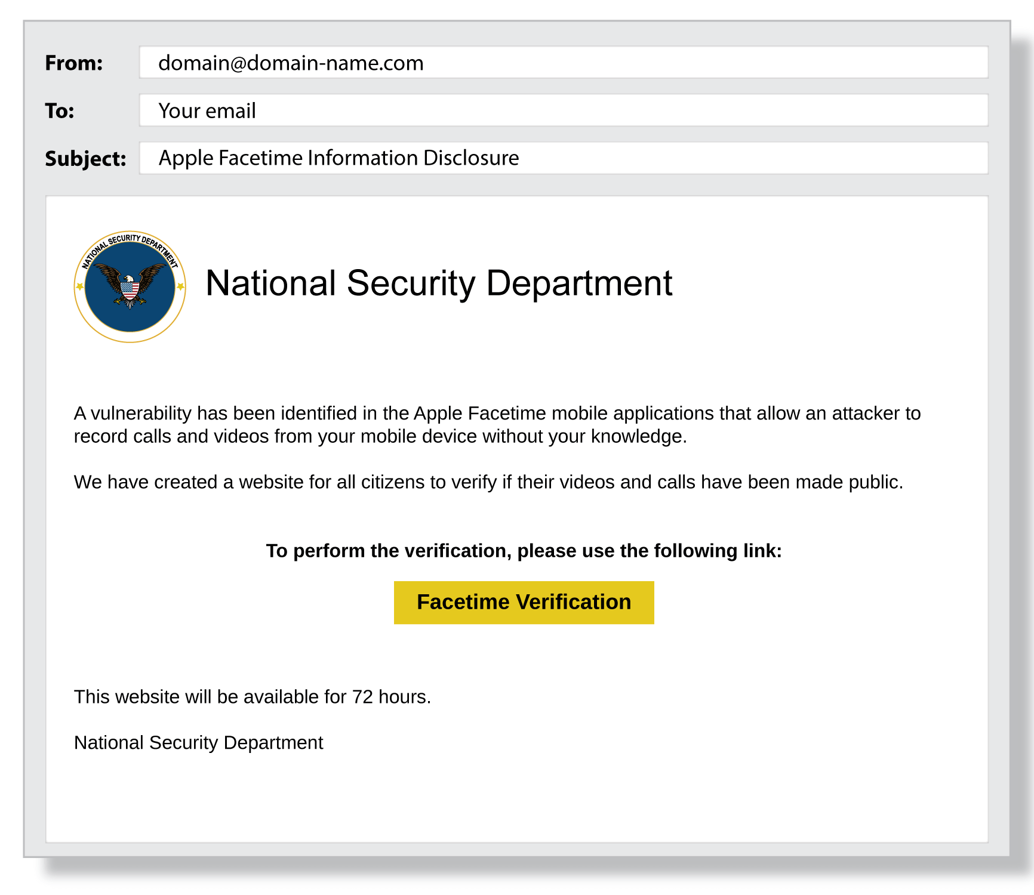
(example of phishing email)

Slide 13
WHAT ARE THE DANGEROUS OF PHISHING ATTACK ?
Sometimes attackers are satisfied with getting a victim’s credit card information or other personal data for financial gain. Other times, phishing emails are sent to obtain employee login information or other details for use in an advanced attack against a specific company. Cybercrime attacks such as advanced persistent threats (APTs) and ransomware often start with phishing.

Slide 14
How do I protect against phishing attacks ?
User education
One way to protect your organization from phishing is user education. Education should involve all employees. High-level executives are often a target. Teach them how to recognize a phishing email and what to do when they receive one. Simulation exercises are also key for assessing how your employees react to a staged phishing attack.
Security technology
No single cybersecurity technology can prevent phishing attacks. Instead, organizations must take a layered approach to reduce the number of attacks and lessen their impact when they do occur. Network security technologies that should be implemented include email and web security, malware protection, user behavior monitoring, and access control.

Slide 15
Four Ways To Protect Yourself From Phishing
Protect your computer by using security software. ...
Protect your cell phone by setting software to update automatically. ...
Protect your accounts by using multi-factor authentication. ...
Protect your data by backing it up.

Slide 16
Causes of Phishing
Email is widespread - users with little to no cyber security awareness will use email and they’re easy to target
Fewer complications - they don’t need to bypass strict security protocols
Potential for wide net - phishing can lend itself to targeted attacks (spear phishing) or non-targeted, wide net attacks to gain as many footholds as possible
Versatile technique with many variants - phishing, spear phishing, internal spearphishing and these can be used to deliver various types of malicious code like ransomware

Slide 17
Effects of Phishing
1. Loss of Data
Clicking on a malicious link in an email can hand over the data and system of an organization to a hacker. They are then free to do what they want including theft for further criminal purposes, corruption, and deletion. Data loss is considered the most severe effect of phishing attacks.
2. Damaged Reputation
Companies suffer reputation loss following a data breach executed through phishing attacks. Announcement of a breach leads to loss of trust for the company among the general public. Regardless of an organization’s previous standing, data breaches exert a strong negative effect on its brand and it may be seen as untrustworthy for a long time following a successful hack.

Slide 18
3. Direct Monetary Loss
Extra funds will be needed to manage identity protection, compensation of customers or employees whose data was stolen following a phishing attack. Funds could also be transferred out from a company’s account through impersonation via phishing.
4. Loss of Productivity
Data breaches or system compromise arising from phishing attacks cause business disruption. Following a successful phishing attack, a large part of a business’ time will be spent on trying to recover lost data and investigating the breach with little left for actual business. Employees’ productivity will also take a hit as many systems are put offline for reconfiguration and cleaning.

Slide 19
5. Loss of Customers
Successful phishing attack scares customers away from a business. A UK survey revealed that more than half of consumers stop patronizing a hacked organization for several months after a data breach.
Some 41% of customers no longer patronize businesses that got their data leaked. This effect could haunt an organization for a long time.
6. Financial Penalties
When sensitive customers’ data end up in the public domain, the affected business is held responsible. In addition to the direct monetary loss from failure to defend against phishing, heavy regulatory fines can be placed on an organization for mishandling customer’s data.
The penalties target businesses that don’t follow best practices for protecting their customer’s private data. Violating regulatory requirements such as HIPAA, PCI, and European GDPR may attract heavy fines. The extent of the fines depends on the industry and the scope of the breach.

Slide 20
7. Intellectual Property Theft
A business asset isn’t just money or equipment, intellectual property could even be more important. Intellectual property may be stolen through phishing attacks and could even be the motivation for the attack in the first place.
Heavy investment goes into research and development, new technology as well as trade secrets. When these are compromised, they could setback the business involved and make them less competitive.
8. Loss of Company Value
Phishers can also cost a company a significant part of its market value as a result of the loss of investors’ confidence. Some investors would no longer trust the affected organization and may move their funds elsewhere to protect their portfolio.

Slide 21
conclusion
Phishing campaigns can be difficult spot. Cyber criminals have become experts at using sophisticated techniques to trick victims into sharing personal or financial information.
But the best way to protect yourself is to learn how to spot a phishing scam before you take the bait.
Phishing is a form of scam in which an attacker poses as a legitimate entity or person via email or other forms of communication.

Slide 22
Thank you

